Slide 1
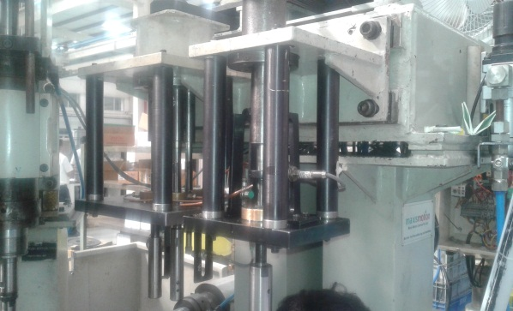
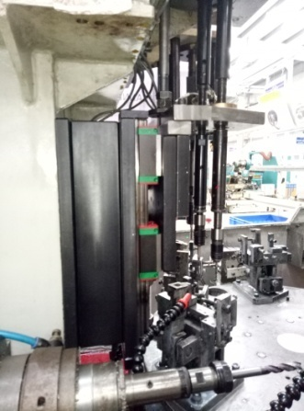
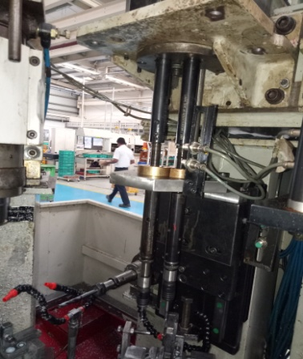
P15
TPM CIRCLE NO :-
ACTIVITY
KK
QM
PM
JH
SHE
OT
DM
E&T
KAIZEN IDEA SHEET
TPM CIRCLE NAME:
LOSS NO. / STEP
DEPT :- Maint.
RESULT AREA
P
Q
A
C
D
S
M
CELL:-Machine shop
CELL NAME:-CBS CELL
MACHINE / STAGE :- New Bkt spm,M5 & M6 taping
OPERATION :- Tapping
KAIZEN THEME: To Increase Productivity
IDEA :. To use pneumatic slide & cyl. For m5 taping unit forward
Problem present status : M5 & M 6 taping unit7 cycle time more i.e 20 sec .
COUNTERMEASURE: Used pneumatic slide & cyl. for M5 & M6 taping forward .
BENCHMARK
20 Sec
TARGET
14 Sec
KAIZEN START
10.10..2016
KAIZEN FINISH
28.12.2016
TEAM MEMBERS: Sujit , Rahul
BENEFITS : 1)Cycle time reduced from
20 sec to 14 sec
2)MTBF Increased
Before
After
KAIZEN SUSTENANCE
WHY - WHY ANALYSIS :-
1)M5 & M6 taping unit7 cycle time more I.e. 20 sec
2)Taping unit Spindle comes forward & reverse on lead screw
3)Manufacturing design defect
RESULT :-
WHAT TO DO:- Check cyl. & valve
HOW TO DO:- In PM
FREQUENCY :-
Cycle Time Reduced
ROOT CAUSE : Manufacturing design defect
REGISTRATION NO. & DATE:- 10.10.2016
SCOPE & PLAN FOR HORIZONTAL DEPLOYMENT
REGISTERED BY :- Sujit
SR.
NO.
CELL
TARGET
RESPONSIBILITY
STATUS
MANAGER’S SIGN :-SNC
1
M6 Tapping
30.10.16
Sujit
In process

